Slide 1





MACININO—MC101840 Tea Grinder Product Introduction
sales@coffeedazheng.com
+86 18011762132
www.coffeedazheng.com

Slide 2
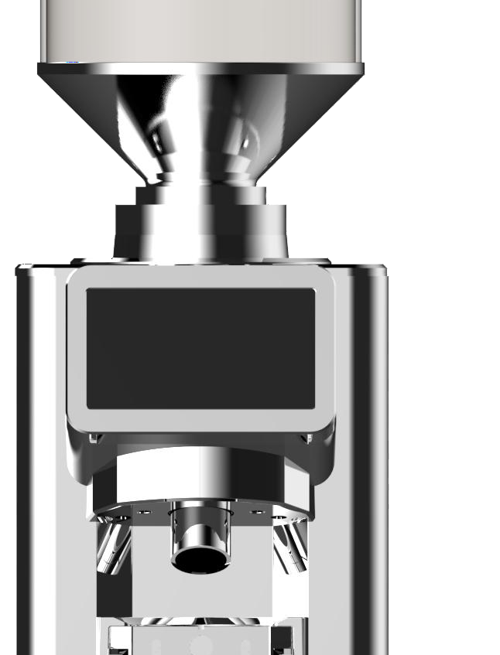
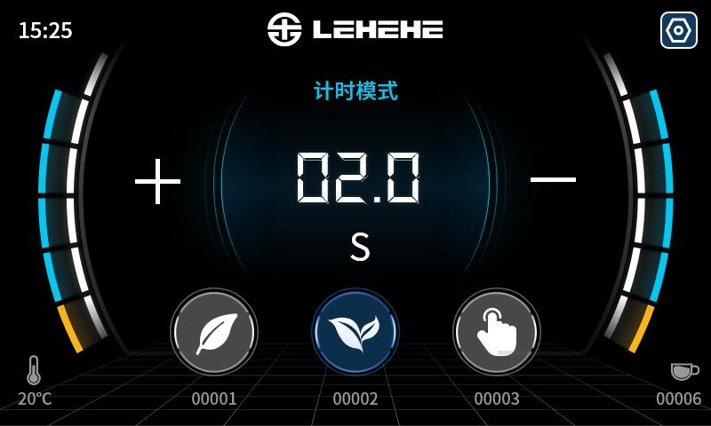
Grinding evenly
Endless release of tea fragrance
stainless steel ghost tooth burr.84mm diameter large burr.coarse and fine grinding is adjustable
MACININO
MC101840
Tea Grinder

Slide 3


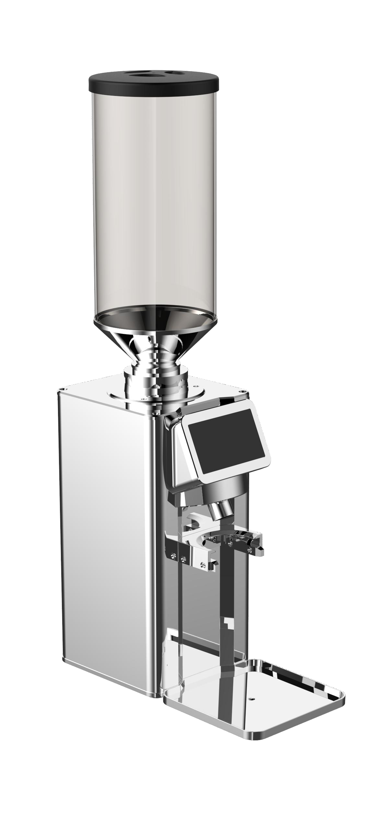
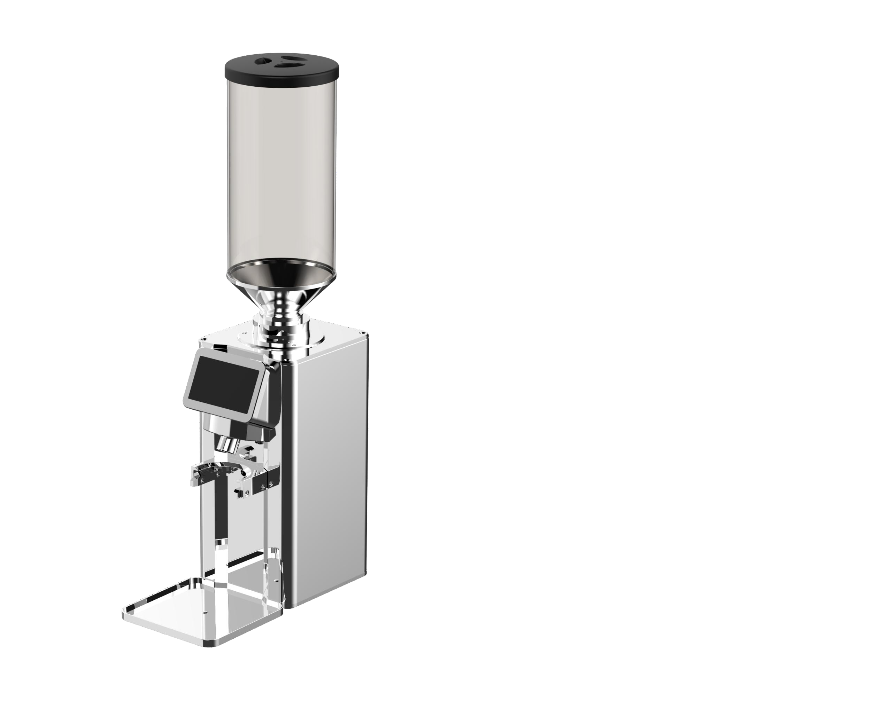
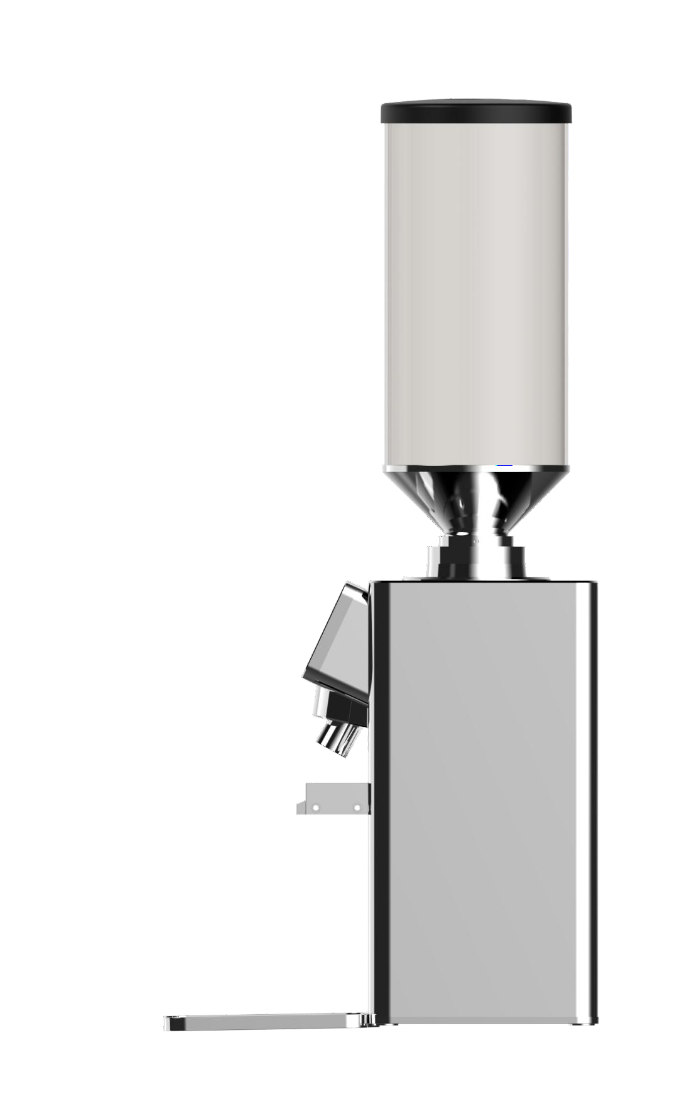

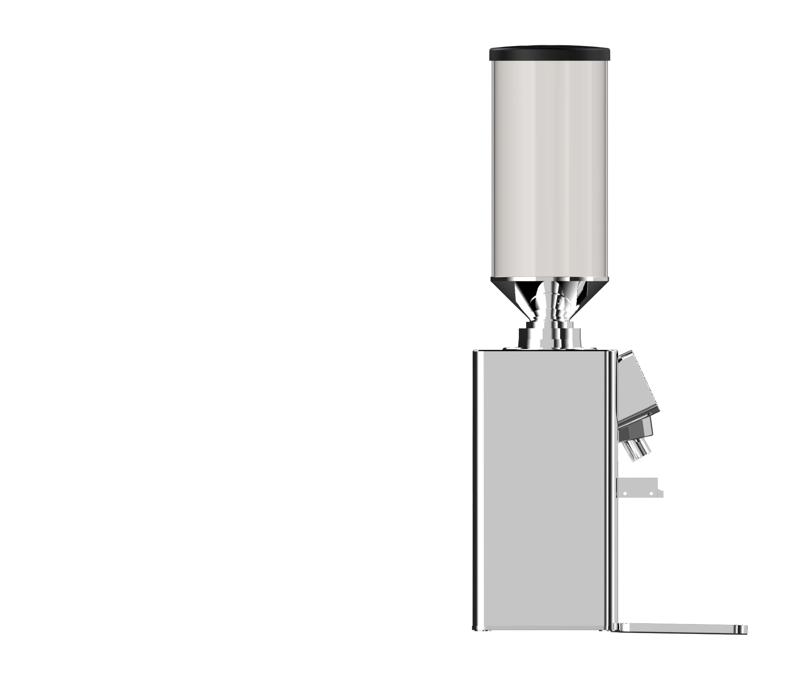
Product View
Front View
Left 45°View
Right 45°View
Left View
Right View
Rear View

Slide 4
01
P a r t o n e
Parameter

Slide 5
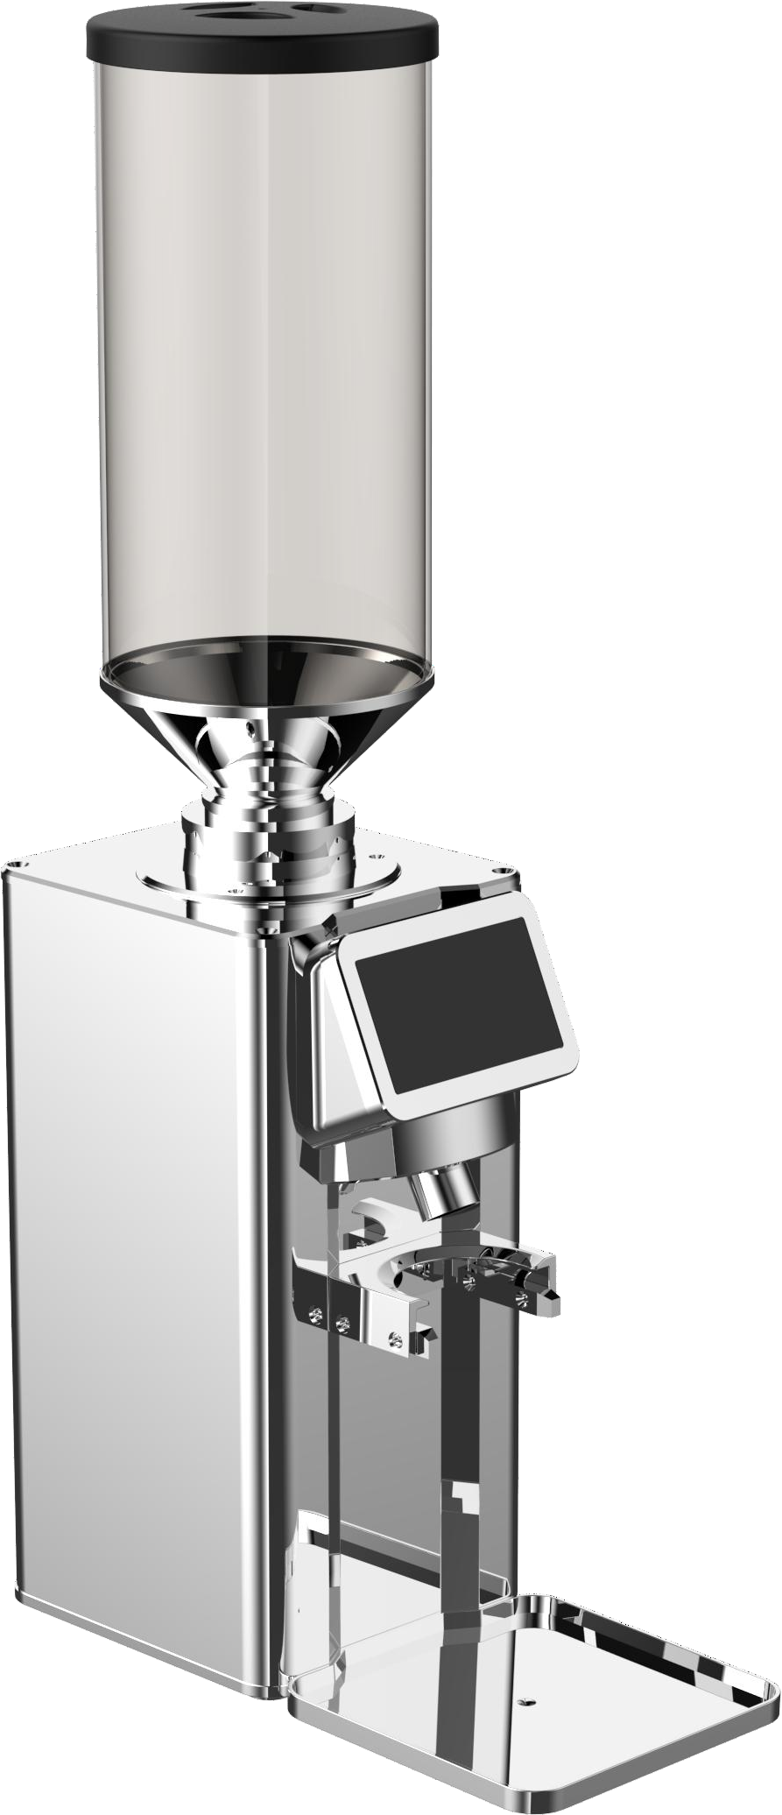
Product Parameter
 | Model | MC101840
 | Colour | Black/White/silver
 | Voltage/Frequency | 220V/50~60Hz
Touchscreen Size |  | 4.3 inches
 | Speed Range | 400-1000rpm
 | Cutting disc diameter | 84mm
 | Cutting disc type | Ghost Tooth Blade Disc
 | Cutting disc material | stainless steel
 | Power | 800W
 | Motor type | DC brushless motor
 | Size | 185*255*794mm(With tea storehouse)

Slide 6
02
P a r t T w o
Functional advantages

Slide 7
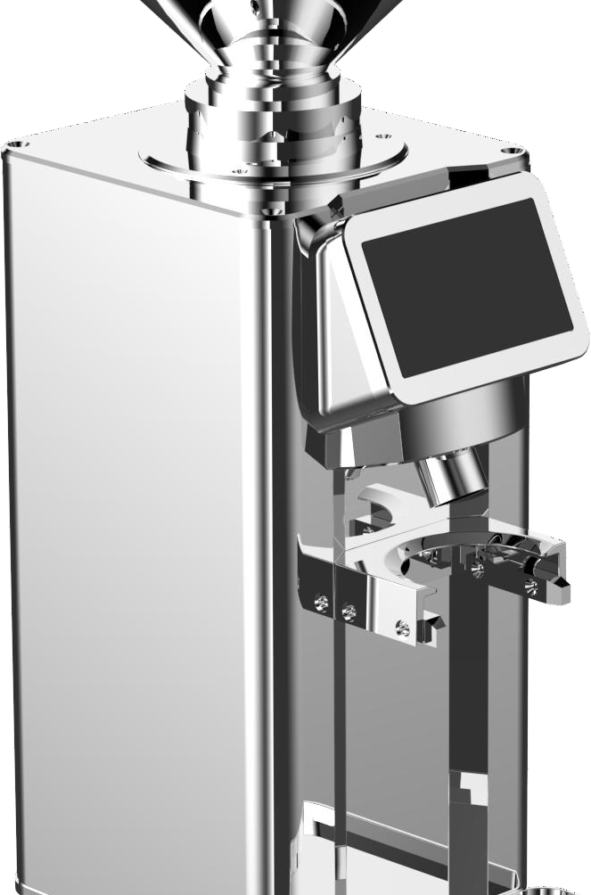

84mmDiameter
Stainless steel grinding tea Ghost Tooth Blade Disc
84mmDiameter
Improve the fineness of grinding
Use the grinding tea Ghost Tooth Blade Disc
Ensure even and fine tea powder; prevent blockage of handle, worry-free grinding.

Slide 8
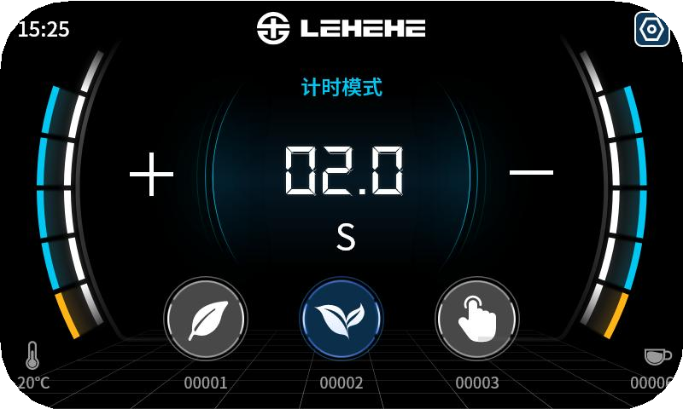
4.3inches Touch screen
More convenient to operate,single, double and manual flour dispensing touch keys are provided.Customizable standard powder amount to meet a variety of tea extraction needs.

Slide 9
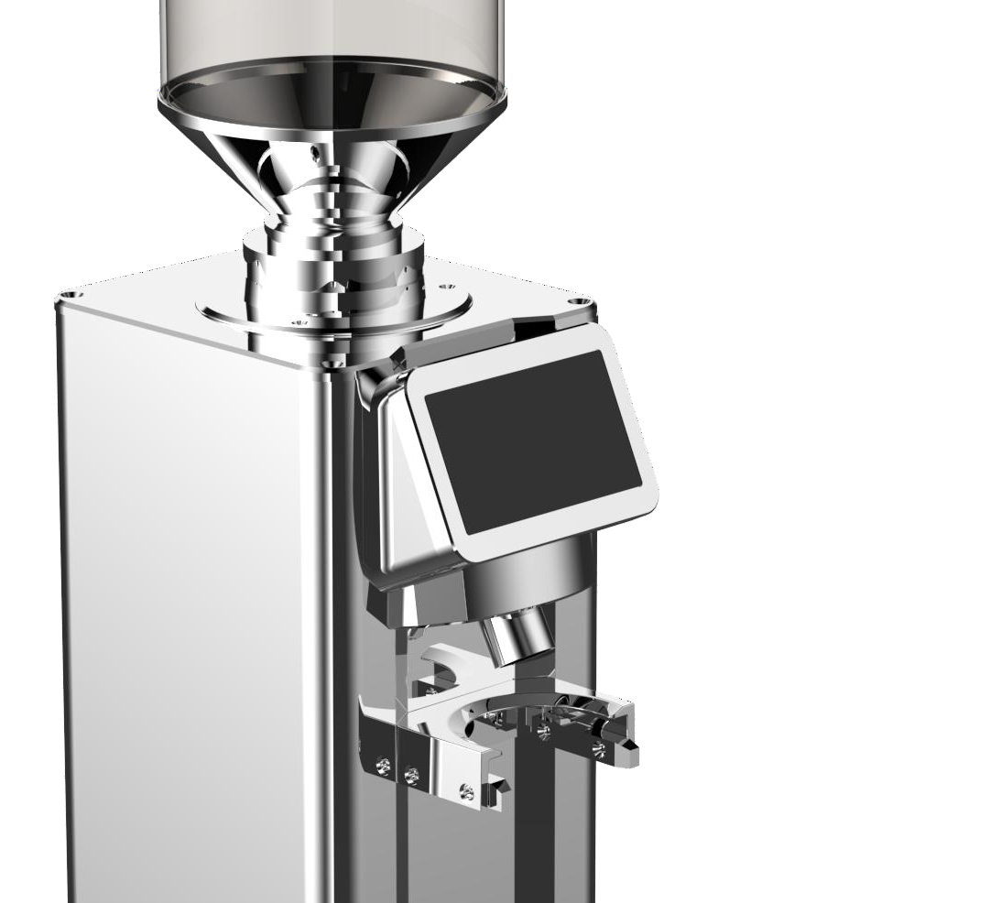

80gear grinding dial
Continuous grinding scale disk
Support multiple grinding fineness adjustment
Meet the grinding formula needs for different tea products
green tea
black tea
oolong tea

Slide 10
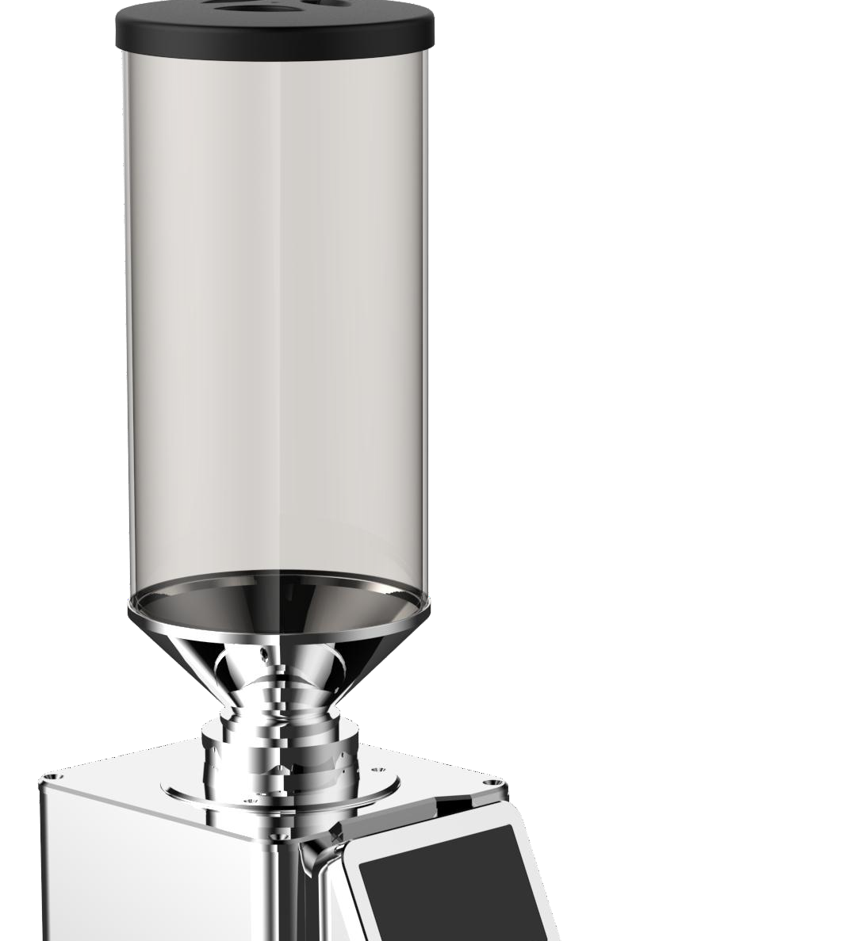

Brown straight barrel tea chest
Retain the essence of tea
Tea colored straight tea storehouse
Reduce the oxidation caused by direct sunlight，Retain the authentic flavor of tea
Straight-tube shape suitable for a wide range of uses，feed smoothly without the worry of blockage.

Slide 11

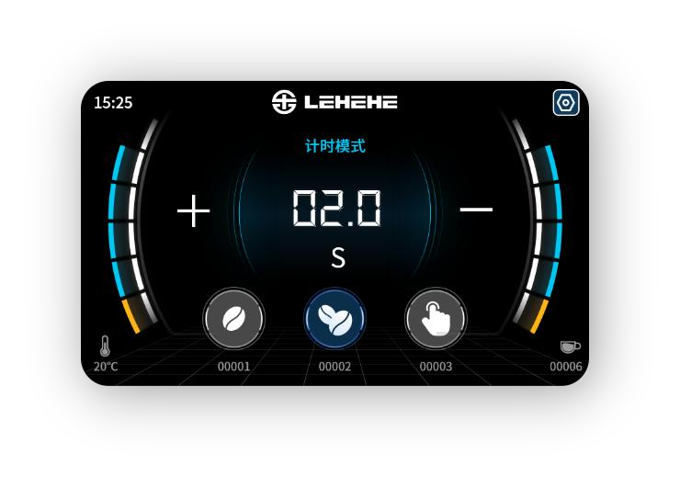
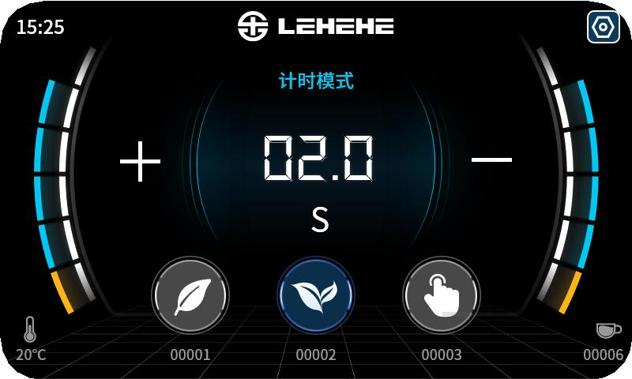


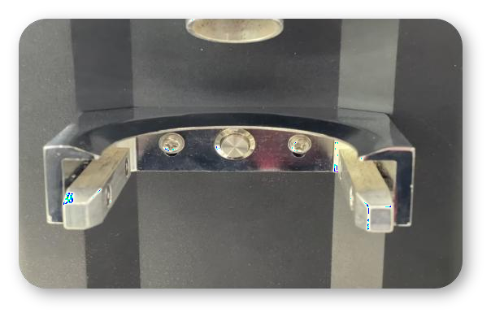


Smart Touch Screen
Tap the screen to get powder
Powder amount control as you wish
Touch the button to take powder
Powder amount control as you wish
Sensor-Based Touch Activation

Slide 12



Real-time detection of internal device temperature
Effectively control the quality of the product
Real-time monitoring of the internal temperature of the equipment
Control the quality of the product
Standardize product development

Slide 13


THANKS
COFFEE & TEA
SYSTEM SERVICE PROVIDER
sales@coffeedazheng.com
+86 18011762132
www.coffeedazheng.com

